Slide 1
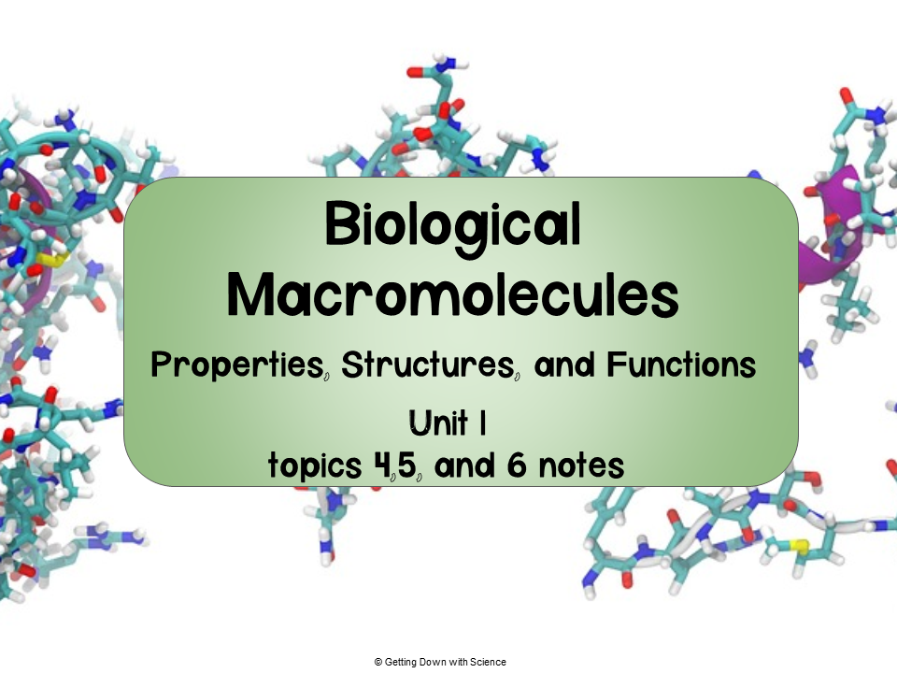

Slide 2
Carbohydrates

Slide 3
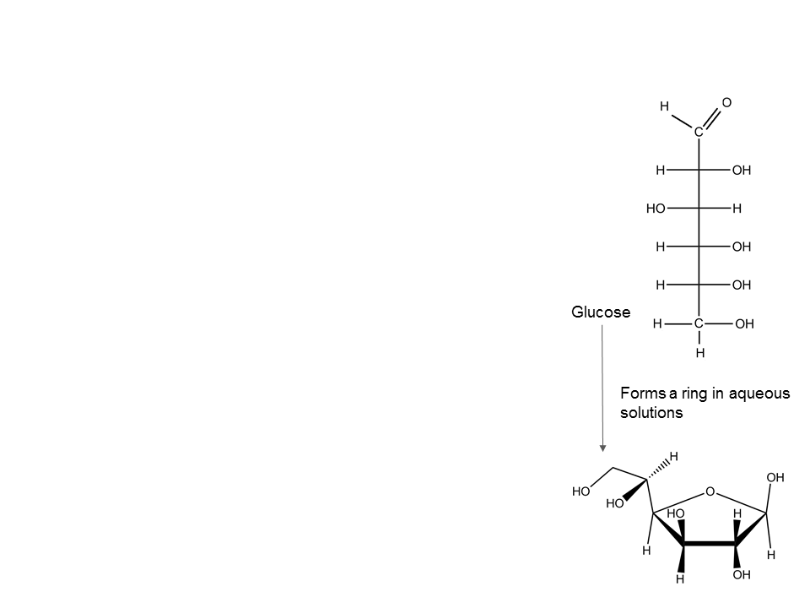
Carbohydrates
Includes sugars and polymers of sugars
Contain a carbonyl group and many hydroxyl groups
Comprised of C, H, and O
Monosaccharides: simple sugars
Molecular formulas with multiples of the unit CH₂O
Most common is glucose
  Nutrients and fuel for cells
    Used in cellular respiration
Can serve as building blocks for amino acids, or as monomers for di- and polysaccharides

Slide 4
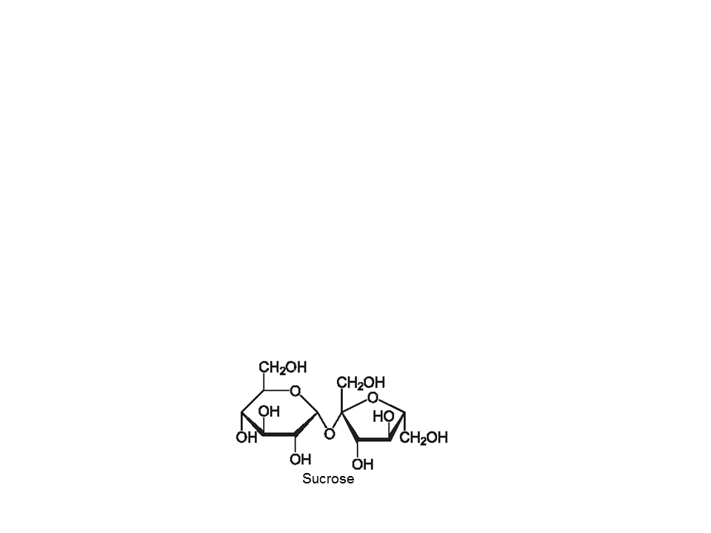
Carbohydrates
Disaccharides: two monosaccharides joined together by covalent bonds
Most common is sucrose
  Monomers of sucrose: glucose and fructose
  Plants transfer carbohydrates from roots to leaves in the form of sucrose

Slide 5
Carbohydrates
Polysaccharides: polymer with many sugars joined via dehydration reactions
Storage polysaccharides
Plants store starch (polymer of glucose monomers)
  Allows plants to store excess glucose
Animals store glycogen (polymer of glucose)
  Stored in liver and muscle cells
Structural polysaccharides
Cellulose: tough substance that forms plant cell walls
Chitin: forms exoskeleton of arthropods

Slide 6
Practice
You are given an unknown monosaccharide to identify in the lab. The only clue you are given is that it has 4 carbons. You (being an excellent AP bio student) figure out the formula and name immediately. What is the unknown monosaccharide?
Answer: C4H8O4, Threose
Notes:
1. I allow students to search up the formula once they figure that out to determine the name. C4H8O4, Threose

Slide 7
Proteins

Slide 8


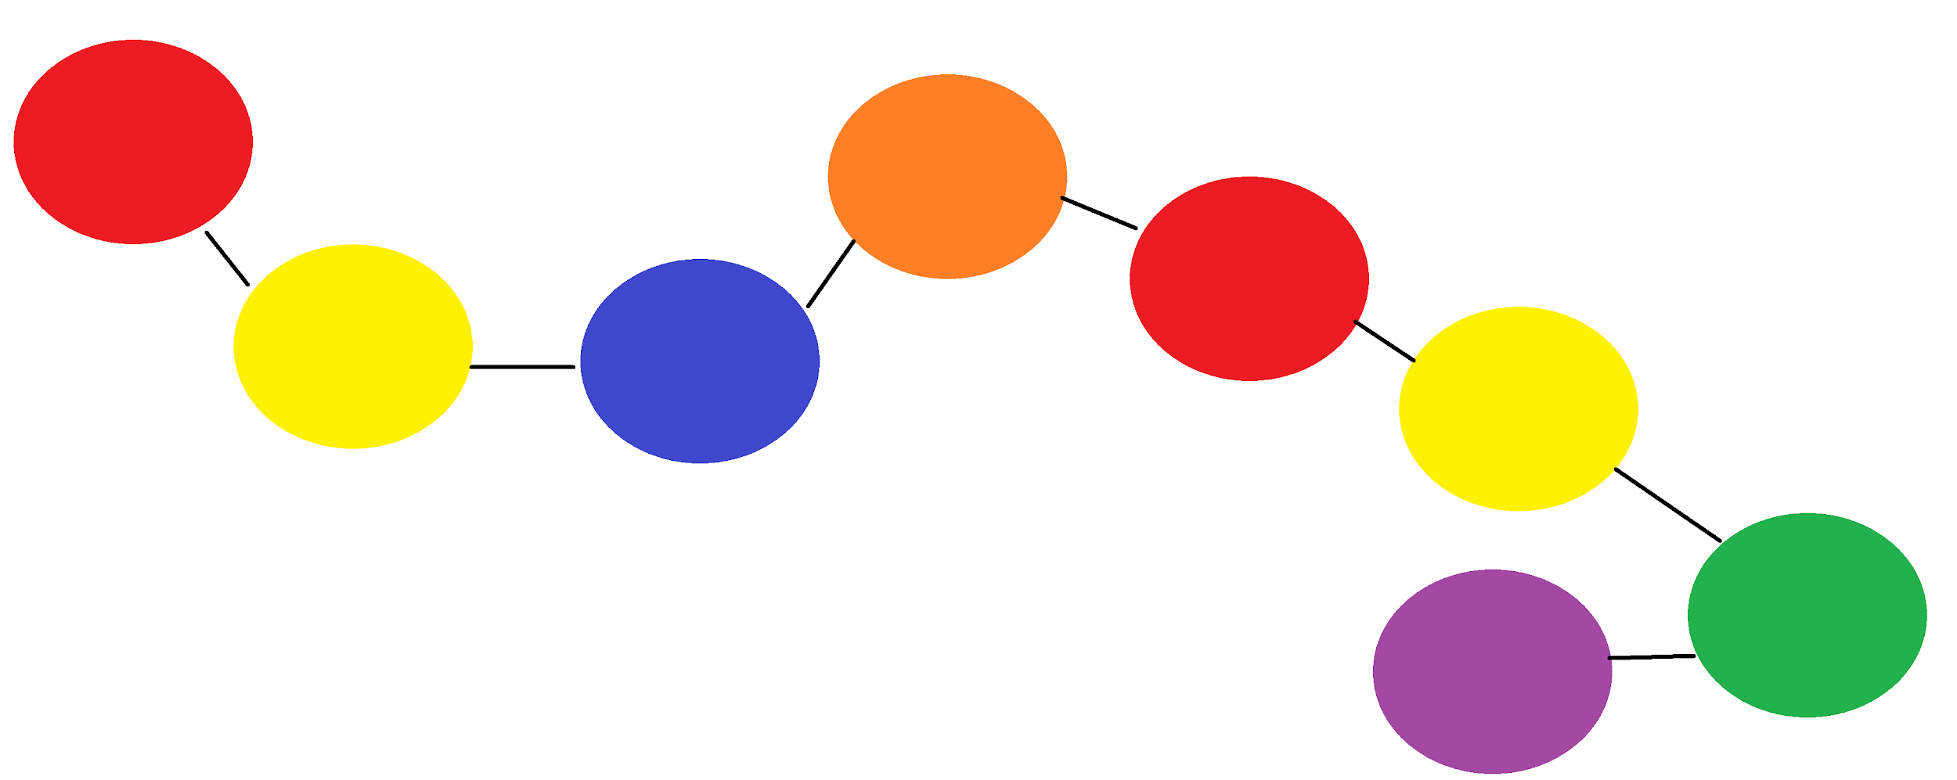
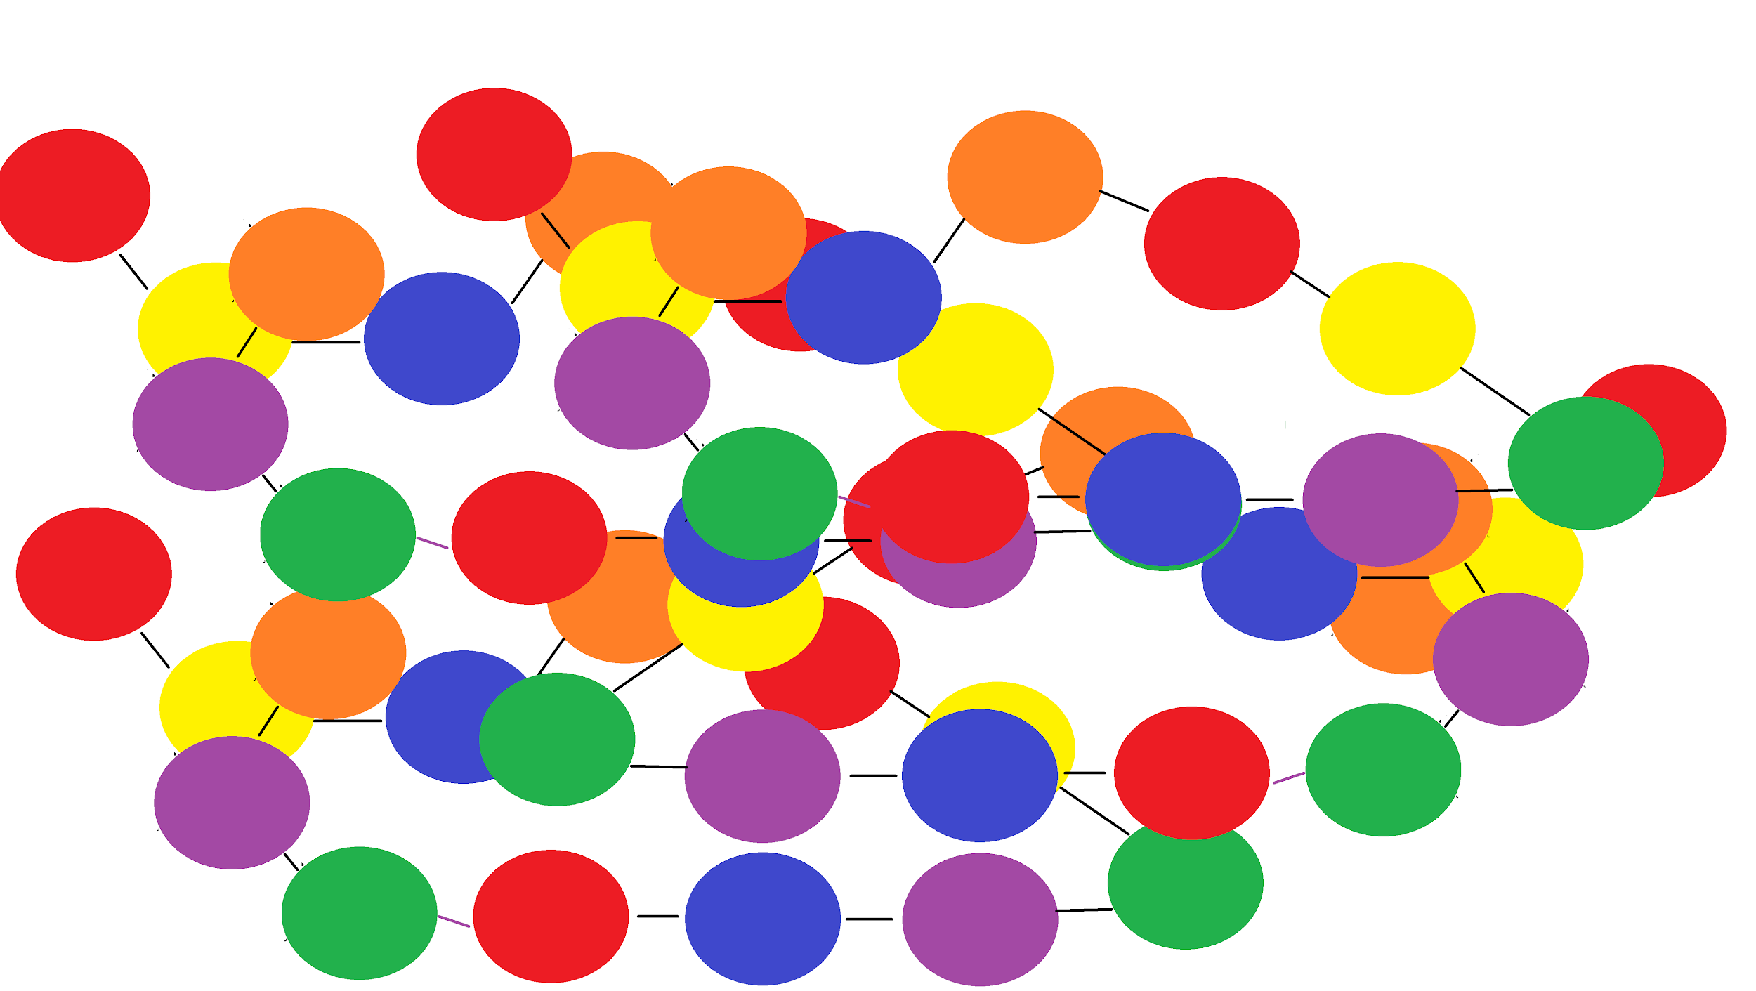
Formation of a Protein
Amino acid
Peptide
Polypeptide
Protein
small
large

Slide 9
Proteins
Molecule consisting of polypeptides (polymers of amino acids) folded into a 3D shape
Comprised of C, H, O, N, and S
Shape determines function

Slide 10
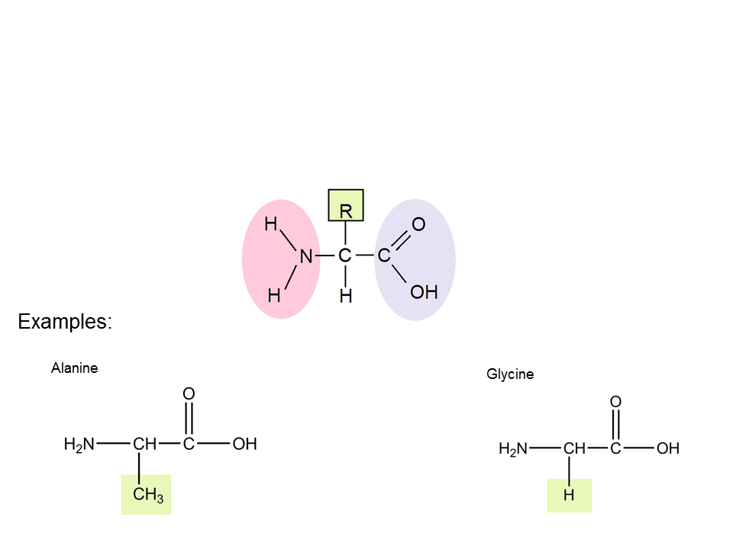
Amino Acids
Molecules that have an amino group and a carboxyl group
20 different amino acids
General Structure
R = variable side chain
Amino group
carboxyl group
Unique side chain (R)

Slide 11
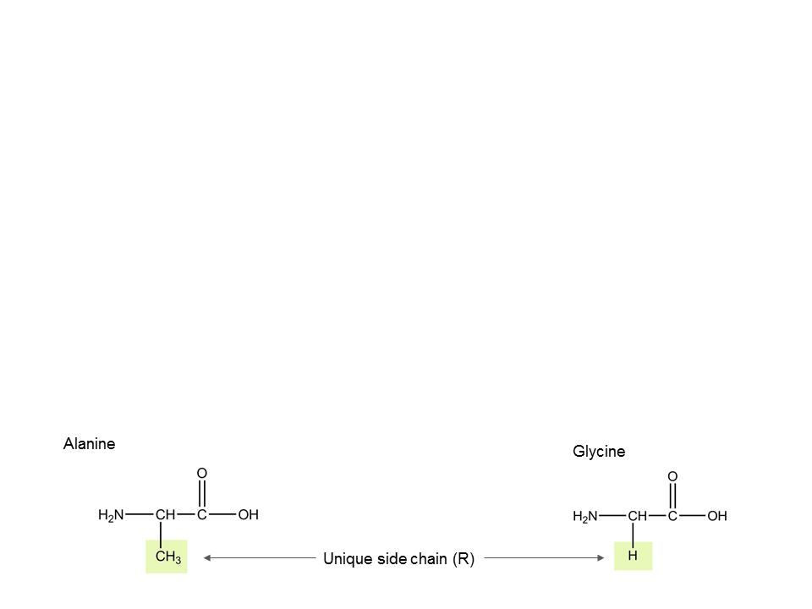
Amino Acids
Each amino acid (AA) has a unique side chain
  Unique aspects of the AA are based on the side chain’s physical and chemical properties
  Side chains can be grouped as:
    Nonpolar (hydrophobic)
    Polar (hydrophilic)
    Charged/ionic (hydrophilic)
  Side chains interact, which determine the shape and function of the protein

Slide 12
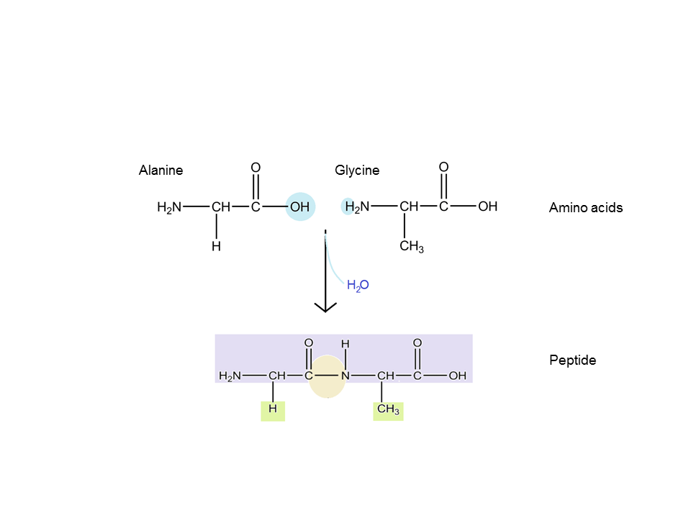
Formation of Peptide Bonds
To form a peptide bond the carboxyl group of one AA must be positioned next to the amino group of another AA
Dehydration reaction
Repetitive backbone
Side chains
Peptide bond

Slide 13
Polypeptides
Many AA linked by peptide bonds
Each polypeptide has a unique sequence of AAs and directionality
Each end is chemically unique
  One end is a free amino group (N-terminus)
  One end is a free carboxyl group (C-terminus)

Slide 14
Polypeptides
Sequence of AAs determines the 3D shape
Remember: SHAPE determines FUNCTION
  When a polypeptide twists and folds (because of R group interaction) it forms a protein
Quick! Think, pair share
How is the unique sequence of AAs determined for a polypeptide?
Genes

Slide 15
Functions of Proteins
Function of proteins include:
  Antibody-help protect the body from disease
  Enzyme- carry out chemical reactions or assist in creating new molecules
  Messenger- transmit signals (ie hormones)
  Structural- provide structure and support
  Transport/storage- bind to and carry small atoms and molecules through the body

Slide 16
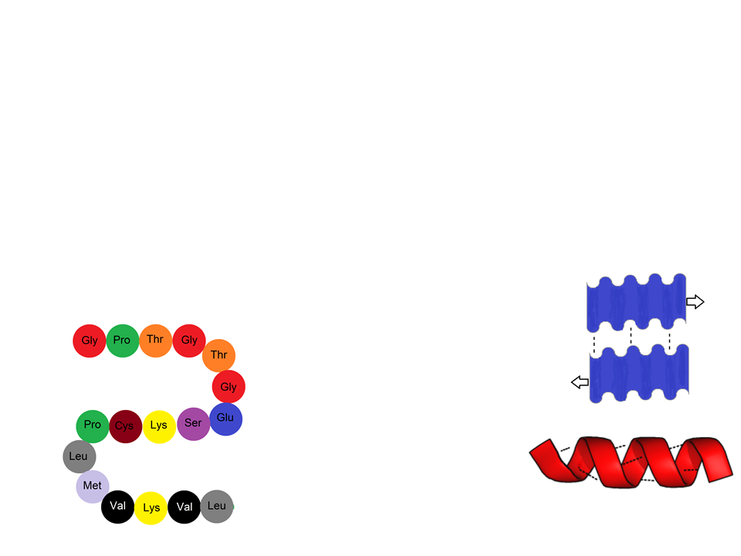
Levels of Protein Structure
Primary
Secondary
Linear chain of AA
Determined via genes
Dictates secondary and tertiary forms
Coils and folds due to hydrogen bonding within the polypeptide backbone
𝛃 pleated sheet- hydrogen bonds between polypeptide chains lying side by side
𝛂 helix- hydrogen bonding between every 4th AA

Slide 17
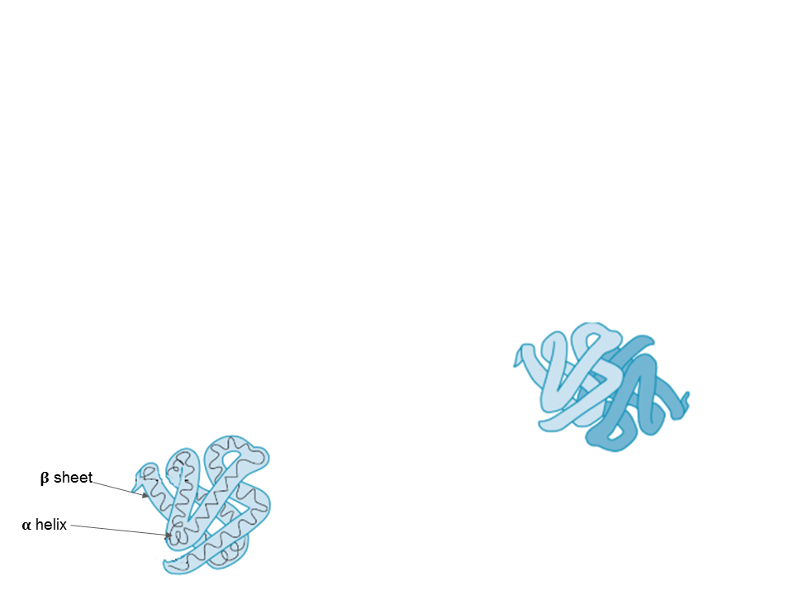
Levels of Protein Structure
Tertiary
Quaternary
3D folding due to interactions between the side chains of the AAs
Reinforced by hydrophobic interactions and disulfide bridges of the side chains
  The covalent bond formed between sulfur atoms of two cysteine monomers
Association of two or more polypeptides
Found in only some proteins
All four levels of a protein’s structure determine the protein’s function

Slide 18
Practice FRQ
Cystic fibrosis is a serious, life-threatening disease that affects the lungs and digestive system of affected individuals. This disease results from the deletion of three nucleotides on the Cystic Fibrosis Transmembrane Conductance Regulator (CFTR) gene. This gene codes for a transmembrane protein that regulates ion channels in epithelial tissue. Provide an explanation for how this deletion could result in cystic fibrosis.
Notes:
I provide students a little more help with this problem or allow them to do additional research on their own to answer the question.
Answer: The deletion of the nucleotides causes the primary structure of the protein it codes for to change. This in turn affects the 3D (tertiary) structure of the protein

Slide 19
Practice FRQ
Saliva is produced and secreted by salivary glands. Saliva is a combination of water, electrolytes, and enzymes that aid in early digestion. One important enzyme in saliva is alpha amylase, which begins the digestion of starch into maltose. A) Identify the type of monomer of which alpha amylase is composed. B) Identify and explain how the reaction that allows for alpha amylase to break down starch occurs. C) The optimum pH range for alpha amylase is 6.7 to 7.0. Predict what would happen if the pH of the mouth increased to 8.5.
Notes:
A) Amino acids are the monomers of enzymes (remember enzymes are proteins).
B) A hydrolysis reaction allows for alpha amylase to break down starch to maltose. A hydrolysis reaction would use water to break the bonds that hold starch together into their smaller components, maltose.
C) If the pH of the mouth increased to 8.5, which is outside of the optimal range for alpha amylase, the enzyme would no longer be able to function optimally OR it would be denature

Slide 20
Nucleic Acids
Topic 6

Slide 21
Nucleic Acids
Nucleic Acids: polymers made of nucleotide monomers
Function to:
Store, transmit and express hereditary information
Two forms:
Deoxyribonucleic acid (DNA)
Ribonucleic acid (RNA)

Slide 22
Components of Nucleic Acids
Nucleotides
Polynucleotides
Nucleic Acids

Slide 23
Nucleotides
Contain 3 parts:
Nitrogenous base
Five carbon sugar (pentose)
Phosphate group(s)
In polynucleotides each monomer only has one phosphate group

Slide 24
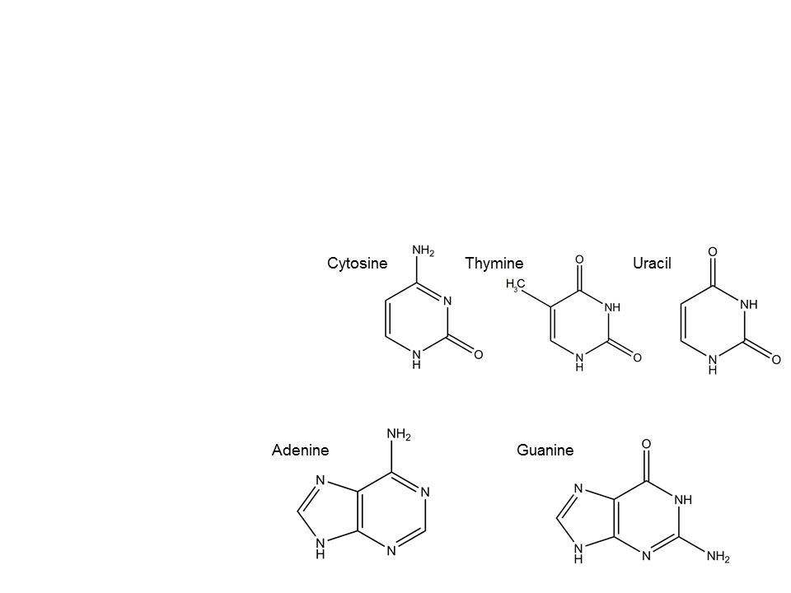
Nitrogenous Base
Two types: pyrimidines and purines
Pyrimidines: one ring with 6 atoms
Cytosine
Thymine
Uracil
Only found in DNA
Only found in RNA
Purines: one ring with 6 atoms bonded to one ring with 5 atoms
Adenine
Guanine

Slide 25
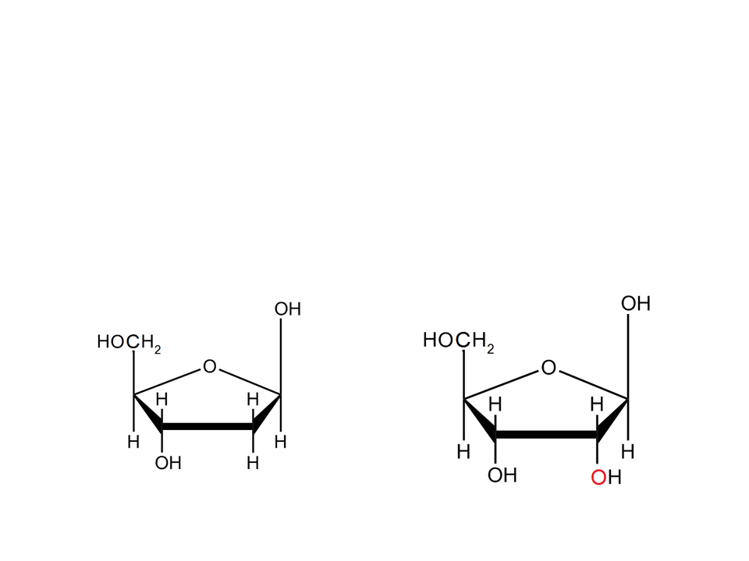
Five Carbon Sugar
A sugar is bonded to the base
In DNA the sugar is deoxyribose
In RNA the sugar is ribose
Differ in structure and function
Deoxyribose
Ribose

Slide 26
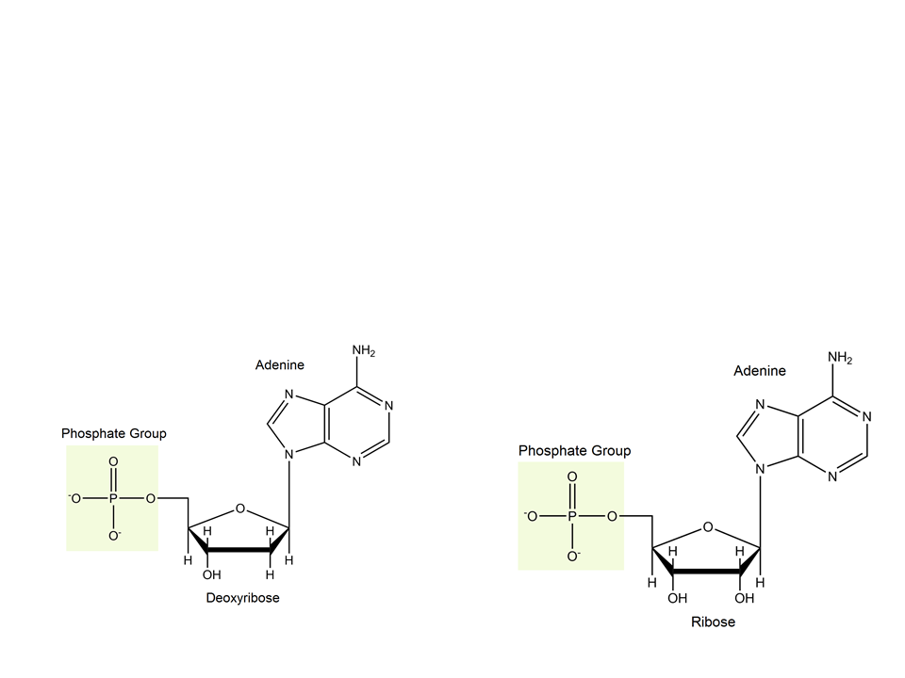
Phosphate Group
A phosphate group is added to the 5’ carbon of the sugar (which is attached to the base) to form a nucleotide
Nucleoside- portion without phosphate group
5’ carbon
5’ carbon
Notes:
If students do not remember how to number the carbons: number the carbon to the right of the oxygen on the sugar, then move in a clockwise motion. Also, remind students that the use of a prime (‘) is to designate the carbons of the sugar

Slide 27
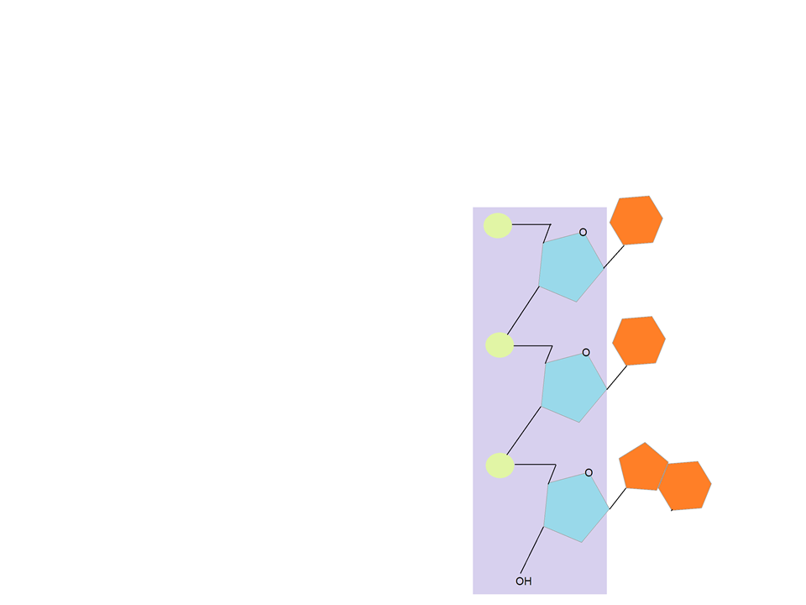
Polynucleotides
Nitrogenous bases
Phosphate groups link adjacent nucleotides
Phosphodiester linkage
Directionality
  5’ to 3’
5’ phosphate end
The sequence of bases along the DNA or mRNA is unique for each gene
Dictates AA sequence
  Dictates primary structure of a protein
    Dictates 3D structure of a protein
Sugar phosphate backbone
3’ hydroxyl end

Slide 28
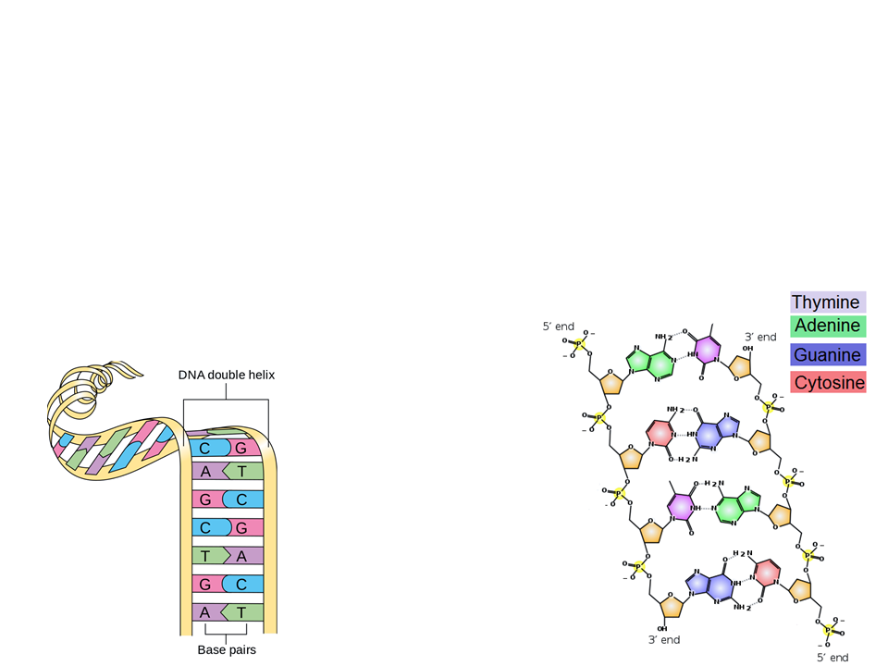
DNA
Consists of two polynucleotides
Forms a double helix
  Strands are antiparallel
  Held together by hydrogen bonds between bases
antiparallel
Cytosine binds to guanine
Adenine binds to thymine

Slide 29
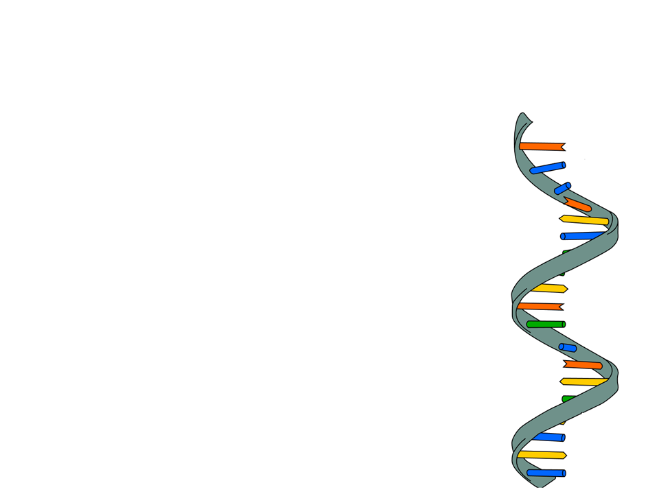
RNA
Single stranded polynucleotide
Variable in shape
  Due to base pairing within RNA
    Adenine bonds to uracil
    Cytosine bonds to guanine

Slide 30
Concept Check
What are the main differences between DNA and RNA?
You are given a fragment of genetic material with the following sequence: ACUGA. Is this DNA or RNA? Why?
Notes:
Students can discuss: the backbone (DNA is deoxyribose RNA is ribose), the bases in DNA are ATCG while the bases in RNA are AUCG, DNA is double stranded while RNA is single stranded, DNA is contained within the nucleus in eukaryotes while RNA can leave the nucleus.
The fragment is RNA because it contains the base uracil.

Slide 31
Practice
You are given a segment of DNA:
  5’- CATGTCAAC-3’
What is the complimentary strand?
Answer: 3’-GTACAGTTG-5’

Slide 32
Lipids

Slide 33
Lipids
Class of molecules that do not include true polymers
Generally small in size
  Often not considered to be a macromolecule
Lipids are nonpolar-hydrophobic
Types of lipids:
Fats
Phospholipids
Steroids

Slide 34
Fats
Fats are composed of glycerol and fatty acids
Glycerol: classified as an alcohol (hydroxyl groups)
Fatty Acids: long carbon chains (carboxyl group at one end)
3 fatty acids join to a glycerol via ester linkage
  Bond between a hydroxyl and carboxyl group
Classified as a saturated fatty acid or an unsaturated fatty acid
  Saturated fatty acid: no double bonds between carbons in the carbon chain = more hydrogen (think: saturated with hydrogen)
  Unsaturated fatty acid: contains one or more double bonds

Slide 35
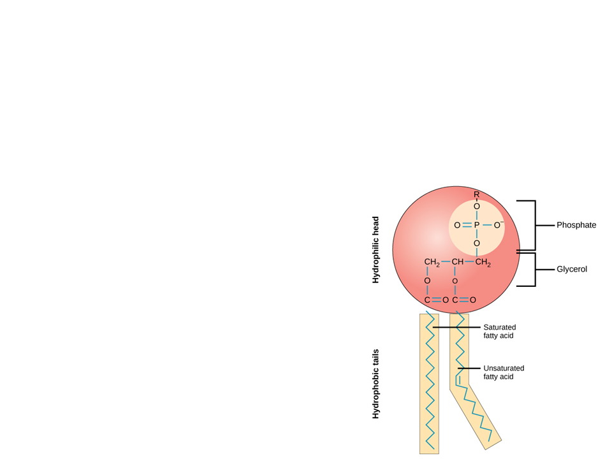
Phospholipids
Major component of cell membranes
Two fatty acids attached to a glycerol and a phosphate
Assemble as a bilayer in H₂O
Tails are hydrophobic
Head is hydrophilic

Slide 36
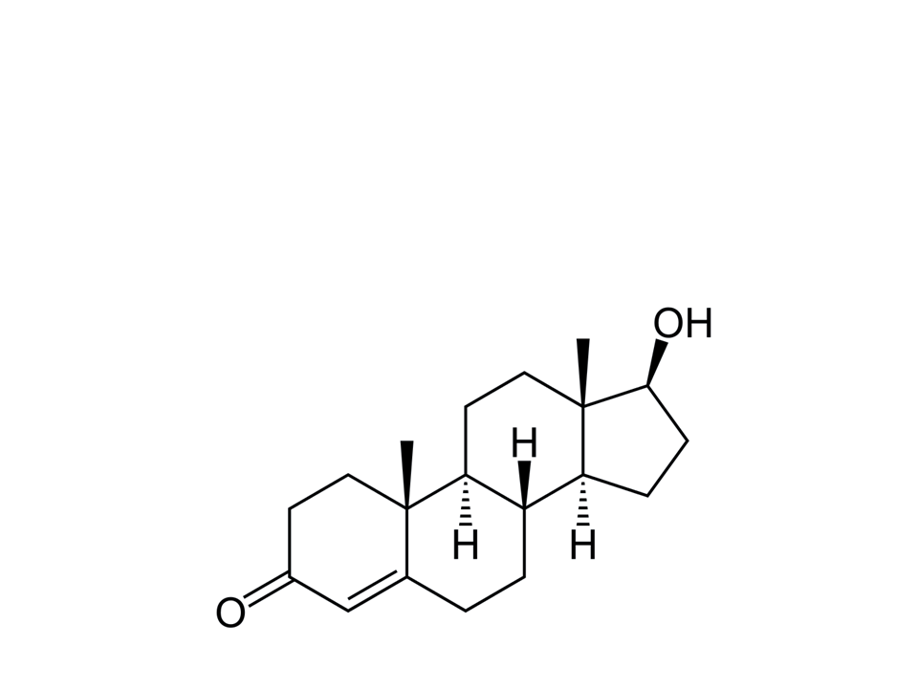
Steroids
Lipids that have four fused rings
Unique groups attached to the ring determine the type of steroid
Example: testosterone

Slide 37
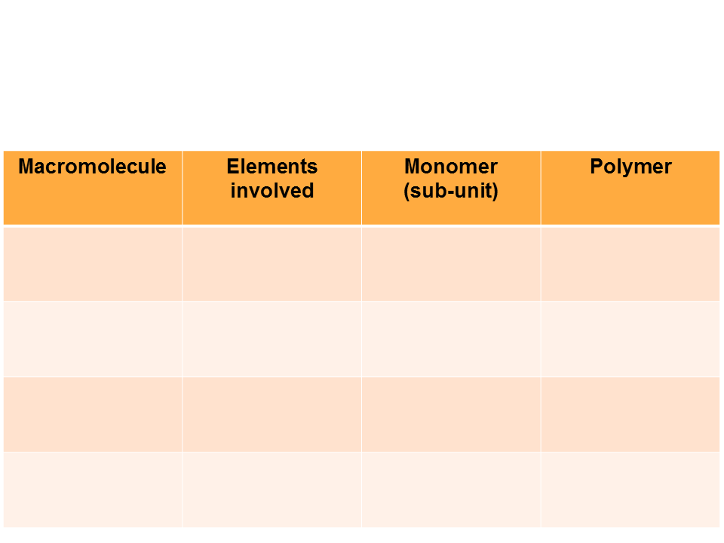
Putting it all together
Fill out this chart with the appropriate responses
Carbon, hydrogen, oxygen
monosaccharide
Carbohydrates
Polysaccharide
Carbon, hydrogen, oxygen, nitrogen, sulfur
Proteins
Amino acids
Polypeptides
Carbon, hydrogen, oxygen (phosphorus for phospholipids)
Glycerol and fatty acids
Lipids
Does not contain true polymers
Carbon, hydrogen, oxygen, nitrogen, phosphorus
Nucleic Acids
Nucleotides
DNA, RNA

